Slide 1
Chapter 30
Transportation Project-Based Scoring System
MDOT Office of Planning Presentation (MACo Roundtable)
12/7/2017

Slide 2
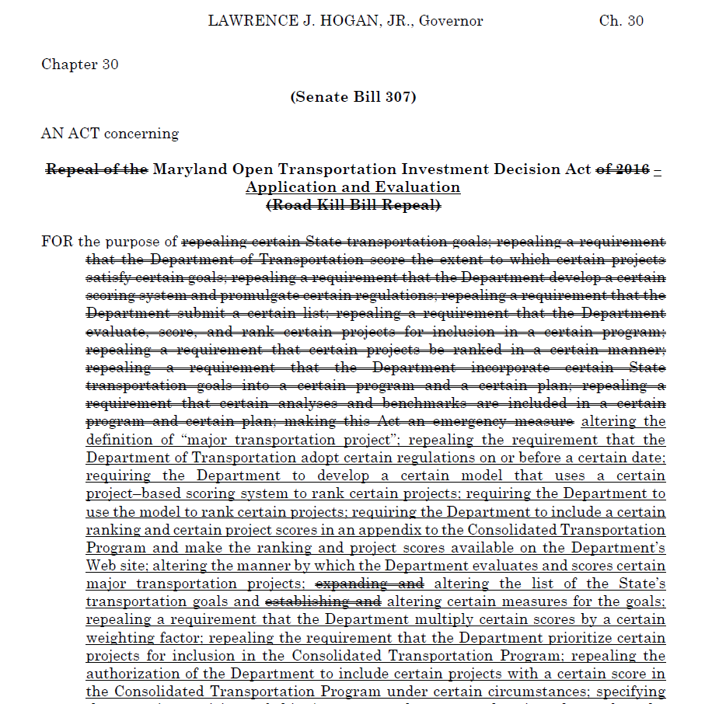
Chapter 30 – Project Scoring Law
New statutory requirements implemented in 2017 legislative session directing the Maryland Department of Transportation to develop by January 1, 2018 a project-based scoring model for evaluating major highway and transit capacity projects over $5 million in the Draft and Final CTP.
Establishes nine goals and twenty-three measures in the law that each major transportation project shall be evaluated against in the project-based scoring model.
Repeals some of Chapter 36 statutory requirements to remove the weighted population factor and provide more discretion to MDOT to develop the model and select projects for funding in the CTP.

Slide 3
Chapter 30 Implementation
A cross-functional team of State transportation officials and local partners developed the scoring model in the Summer of 2017 in order to meet the statutory requirements of Chapter 30.
The Chapter 30 Scoring Model establishes an application process to collect major transportation project candidates and data, conduct project evaluation and modeling and calculate project scores and ranks.
Feedback and comments on the proposed Chapter 30 Scoring Model are being solicited through December via Round Table Forums, MDOT Website & Outreach Activities.

Slide 4
Chapter 30 Implementation
The Chapter 30 Scoring Model will be finalized by January 1, 2018 in accordance with Chapter 30 deadline.
The Chapter 30 Scoring Model will be implemented for all major transportation projects seeking inclusion in the Draft FY 2019-2024 CTP.
The Chapter 30 Scoring Model is one of many tools utilized to select projects for funding in the CTP. However, all major transportation projects must be scored in order to be considered for funding in the CTP.

Slide 5
Project-Based Scoring System
The Chapter 30 Scoring Model evaluates projects against the following nine statutory required goals:
  Each goal has 1-3 measures established by statute that define how the project should be evaluated against it.
  Scores are develop through an objective and transparent process by project application data, project location data, qualitative questionnaires, modeling and forecasting.
Safety & Security
System Preservation
Reducing Congestion
Environmental Stewardship
Community Vitality
Economic Prosperity
Equitable Access
Cost Effectiveness
Local
Priorities

Slide 6
Goal 1: Safety and Security
Measure 1: Expected Reduction in Total Fatalities & Injuries
  Highway Projects – Current Safety Condition (Crash Severity Index) X Safety Features of Project
  Transit Projects – Safety Points Assigned Based off New Transit Passengers Taken Off Roadway (Every 160 New Passengers = 1 Point)
  MDOT will calculate this score for projects.
  Measure 2: Project Implements Complete Streets Policy
  Qualitative Checklist with Points Assigned Based off Project Features Consistent with Complete Streets Safety Policies
  Checklist does not penalize projects in rural areas or areas without pedestrian/bicycle demand that do not need Complete Streets features.
  Combination of MDOT and Applicant Data

Slide 7
Goal 2: System Preservation
Measure 1: Increase in Lifespan of Facility
  Points assigned based off the quantity of assets (lane miles/square feet) in poor or fair condition that the project will address. Assets in poor condition are awarded higher points than those in fair.
  MDOT will calculate this score.
  Measure 2: Increase in Facility Functionality
  Qualitative Checklist based off the functionality features of a project.
  Functionality is defined as improving the current conditions to meet design standards or improve functional deficiencies and not as an increase in throughput of traffic.
  MDOT will calculate this score.
  Measure 3: Degree the Project Renders a Facility More Resilient
  Qualitative Checklist with points assigned based on the project areas risk to flooding and the mitigation features a project includes. Resiliency is defined as resiliency to flooding
  Checklist does not penalize projects in areas not susceptible to flooding and do not require mitigation features.
  MDOT will calculate this score.

Slide 8
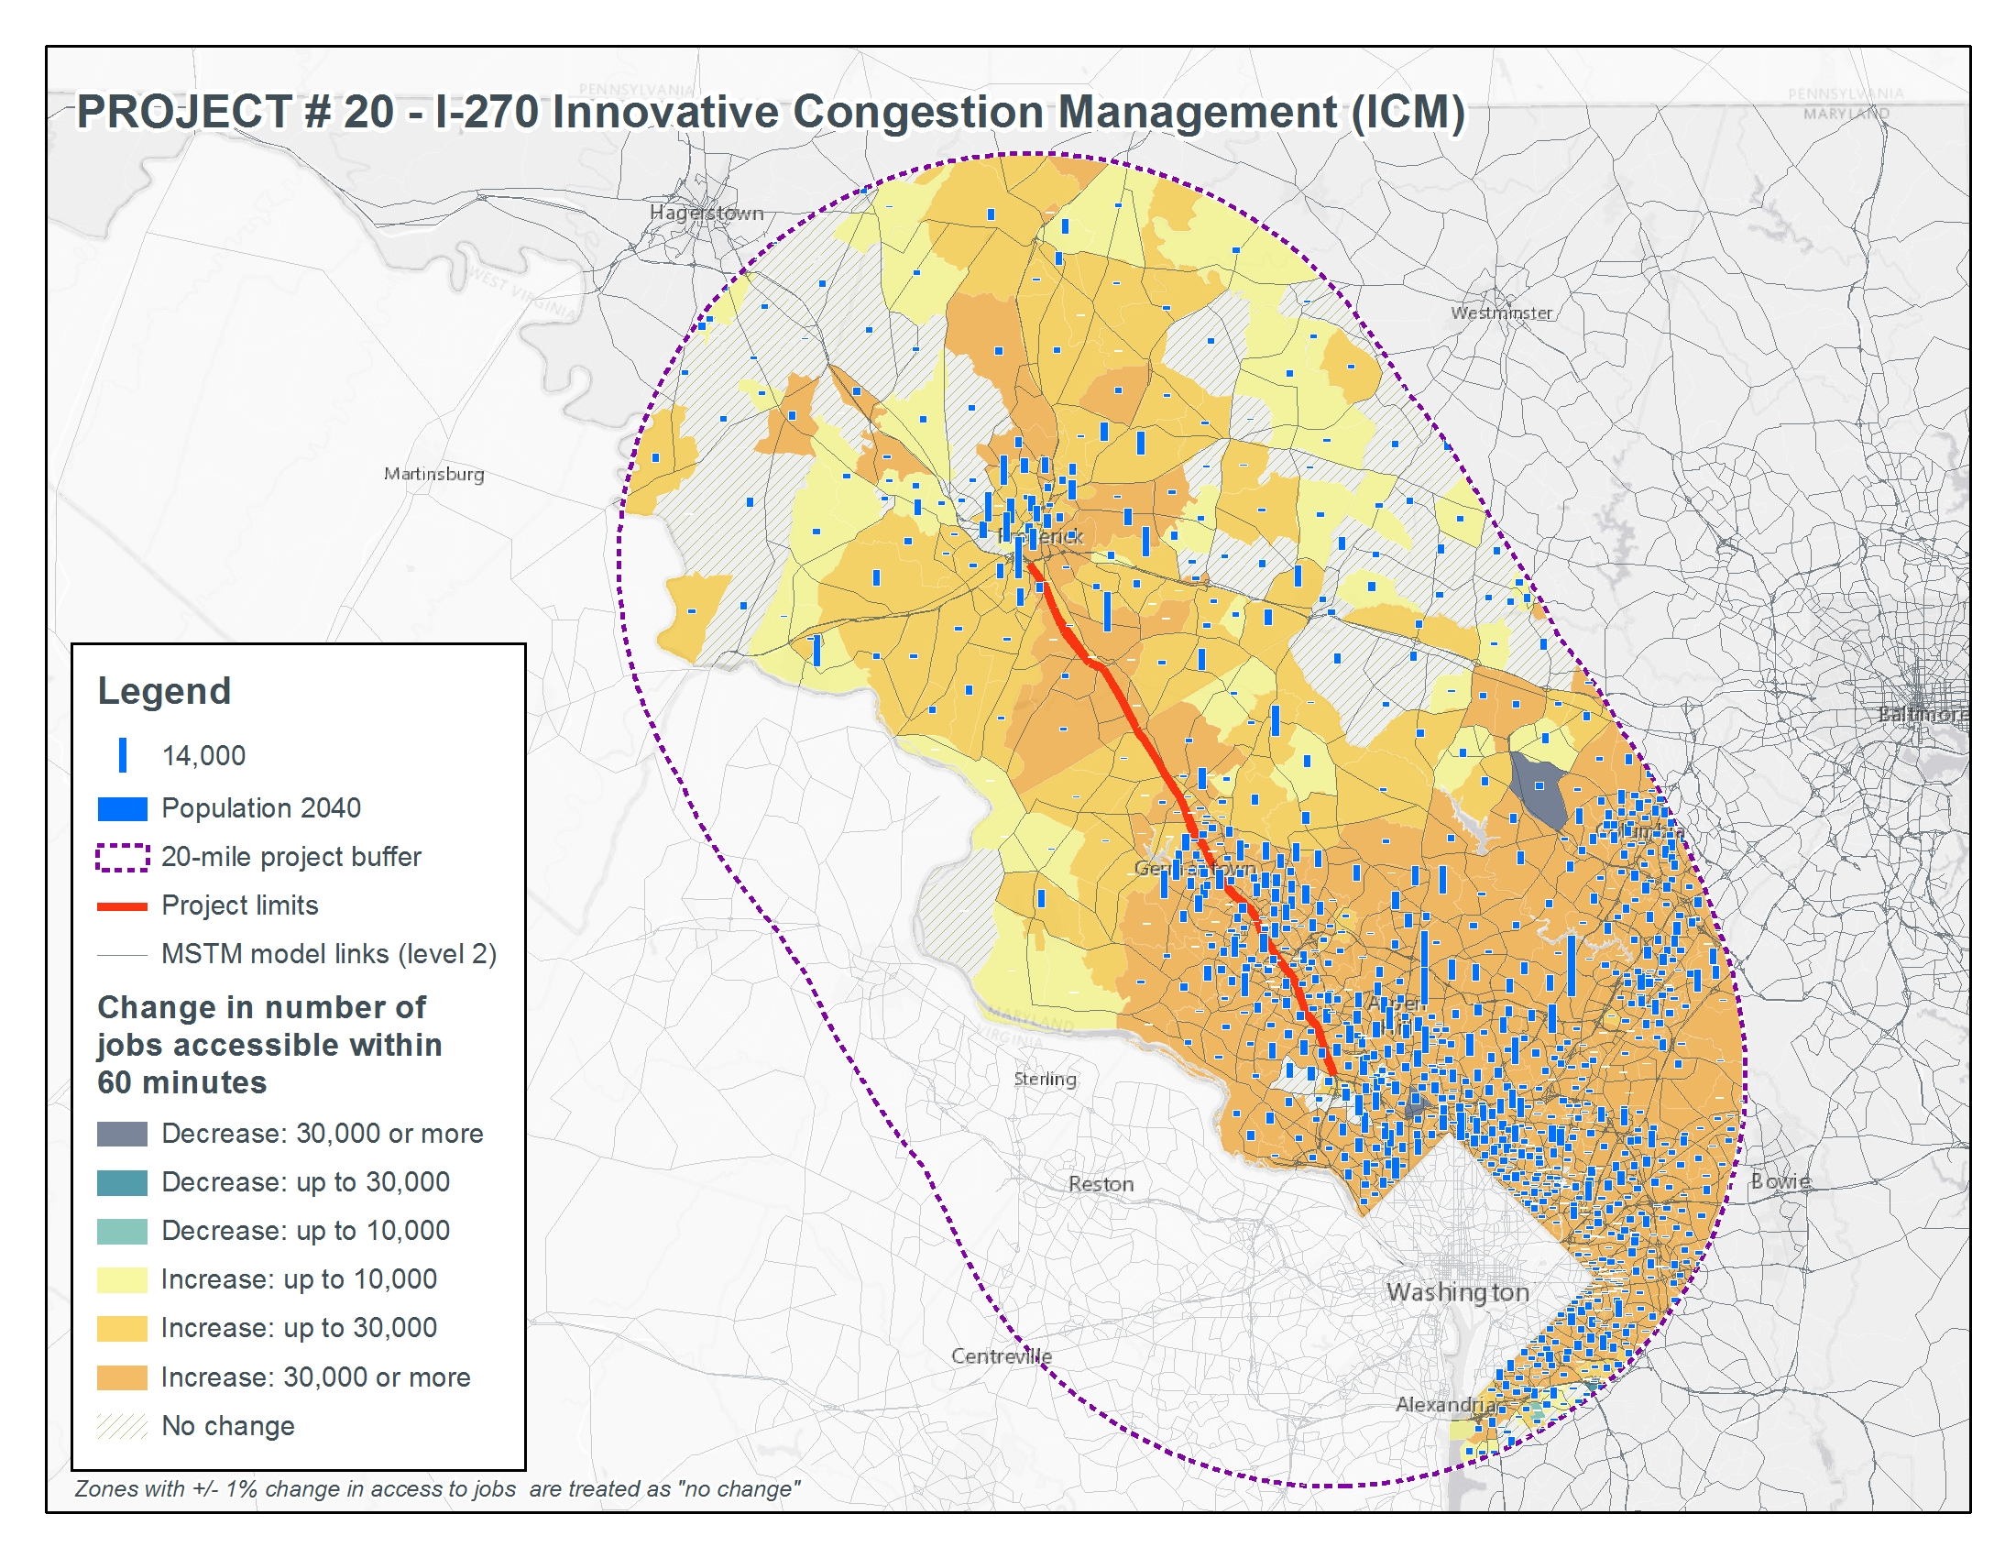
Goal 3: Reducing Congestion
Measure 1: Increase in Job Accessibility
Predicted increase in the number of jobs accessible from modeling the impact in the Multi-Modal Accessibility (MMA) Tool.
This is the same tool Virginia DOT uses to evaluate this same measure in their Prioritization Program.
Measure 2: Increase in Travel Time Reliability
  Highway Projects – Annual travel time savings from project modeled in SHA’s Statewide Travel Demand Model
  Transit Projects – Annual travel time savings based on daily new transit riders. (Every New Passenger is equal to 5.4 minutes of travel time savings).
  Measure 3: Supports Connections Between Different Modes and Promotes Multiple Choices
  Qualitative checklist with points assigned based on the modal connections the project facilities.
  MDOT will calculate score.

Slide 9
Goal 4:Environmental Stewardship
Measure 1: Potential To Limit or Reduce Harmful Emissions
  Highway Projects – Reduced fuel consumption in gallons modeled from SHA’s Statewide Travel Demand Model
  Transit Projects – Reduced fuel consumption in gallons based on daily new transit passengers (Every new passenger is equal to 1/5 of a gallon in fuel reduction).
  Measure 2: Avoidance of State Resources in Project Area
  The number of impacted acres divided by the total project acres
  Impacts considered to only State resources – State Parks and Historical Sites
  Measure 3: Degree to Which the Project Advances State Environmental Goals
  Qualitative Checklist with points assigned based on the consistency with environmental goals
  Worked with Maryland Department of Environmental on development of checklist goals.
  MDOT will calculate score.

Slide 10
Goal 5: Community Vitality
Measure 1: Degree To Which Project Increases Use of Walking, Biking or Transit
  Qualitative checklist with points assigned based on the project features and their impact to improving modal choices and consistency with local bicycle/pedestrian plans.
  MDOT and Applicant Data used to Score
  Measure 2: Enhancement of Existing Community Assets
  Qualitative checklist with points assigned based on the number of community assets to which the project provides access to.
  Community assets are defined as education facilities, places of worship, libraries, military installations, parks, community centers and healthcare facilities.
  Applicant Data used to Score.
  Measure 3: Degree to Which the Project Furthers Revitalization Plans
  Qualitative checklist with points assigned based on the projects consistency with local comprehensive plans
  Applicant Data used to Score.

Slide 11
Goal 6: Economic Prosperity
Measure 1: Increase in Job Accessibility
Predicted increase in the number of jobs from modeling the impact in the Multi-Modal Accessibility (MMA) Tool.
Measure 2: Projected Enhancement of Access to Critical Intermodal Locations
  Points assigned based on the project’s inclusion in MDOT’s Strategic Goods Movement Plan
  Measure 3: Increase in Furthering Non-Speculative Economic Development
  Qualitative checklist with points assigned based on the degree to which proposed development is expected to be built as a result of the project.
  Checklist is modeled off Virginia DOT’s evaluation of economic development in their project prioritization program.
  Applicant Data used to Score.
Rating Description | Points Value
Is the project consistent with the local Comprehensive Plan? (Name of Plan and Approval Date Required) | Consistent with: 0.5 Referenced in: 1
What is the development project’s site plan status? | Submitted: 0.5 Approved: 1
What is the development project site utilities status? | Planned: 0.5 Funded: 1 In-place: 2
Expected Job Density of Proposed Development | Low Density .5 High Density 1
Note: For corridor and transit improvements in developed areas, treat all land area that can be improved as having a submitted site plan and in-place utilities. Scaling will be based on land area. For transit improvements evaluate land area at a 0.5 mile radius from each station.
Total (sum of points) | 0-5

Slide 12
Goal 7: Equitable Access to Transportation
Measure 1: Increase in Job Accessibility for Disadvantaged Populations
Predicted increase in the number of jobs in disadvantaged areas from modeling the impact in the Multi-Modal Accessibility (MMA) Tool.
Disadvantaged areas are defined as population areas greater than 2x the national poverty level or more than 75% minority.
Measure 2: Projected Economic Development in Low-Income Communities
  Qualitative checklist with points assigned based on the degree to which proposed development in low income communities is expected to be built as a result of the project.
  Low-Income communities are defined as census tracks where median family income is < 50%.
  Applicant Data used to Score.

Slide 13
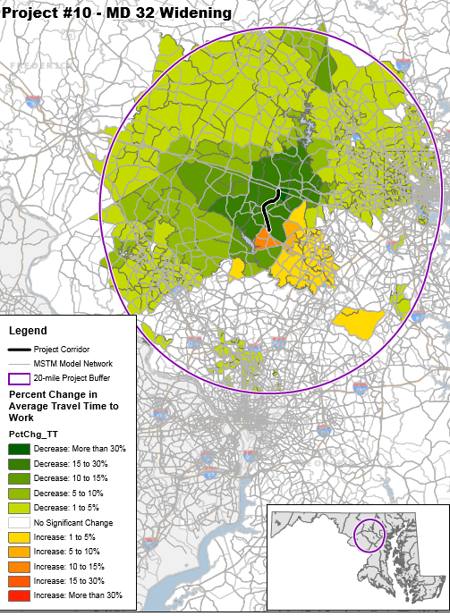
Goal 8: Cost Effectiveness & Return on Investment
Measure 1: Estimated Travel Time Savings Divided By Project Cost
Annual travel time savings calculated in Goal 3 – Reducing Congestion, Measure 2 – Travel Time Savings divided by project cost
Measure 2: Leverage of Additional Federal, State, Local or Private Investment
Total funding contributions form other sources divided by the total project cost.
Applicant Data used to Score.

Slide 14
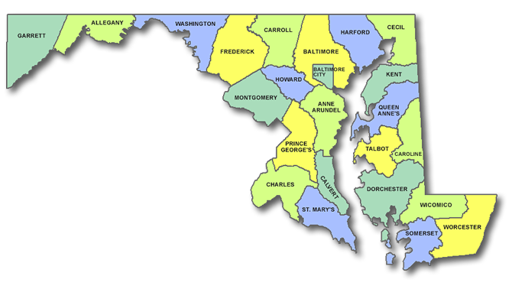
Goal 9: Local Priorities
Measure 1: Degree to Which the Project Supports Local Government Transportation Priorities
A point system will be implemented whereby each County will be given 100 points to assign across their project applications.
This is a best practice recommended by NC DOT and VA DOT to standardize and determine local priorities.
Balancing County & Municipality Needs:
Counties & Municipalities who work together to jointly submit applications for projects will be incentivized with an additional 30 points over what the county assigns it.
If municipalities submit a project application for a project not submitted by the county than the county will forfeit 25 points to the municipality.
If multiple municipalities submit applications for projects not submitted by the county than the county will forfeit 50 points to be split evenly across the municipalities who applied for projects.

Slide 15
Project Scoring Process
Project scores are applied against weighted factors to generate their raw score and then divided by their project cost to get their final overall score and rank.
Safety & Congestion Relief Scores are given the most weight in the model
Economic Prosperity, Local Priorities and Return on Investment scores drive most of the remaining weight in the model.
Chapter 30 Goal Weights

Slide 16
Who Can Propose Major Transportation Projects
The following entities can submit project applications for major transportation projects to be evaluated under the Chapter 30 Scoring Model and considered for funding in the CTP:
  County Government
  Municipal Government
  Government Agency
  Counties and municipalities should have a letter of support from their governing body accompanying any requested project(s)
  Proposing entities are limited to proposing 10 major transportation projects during each annual cycle to be considered for funding in the CTP. This limitation is due to the financial constraint of MDOT to process, model and evaluate projects.

Slide 17
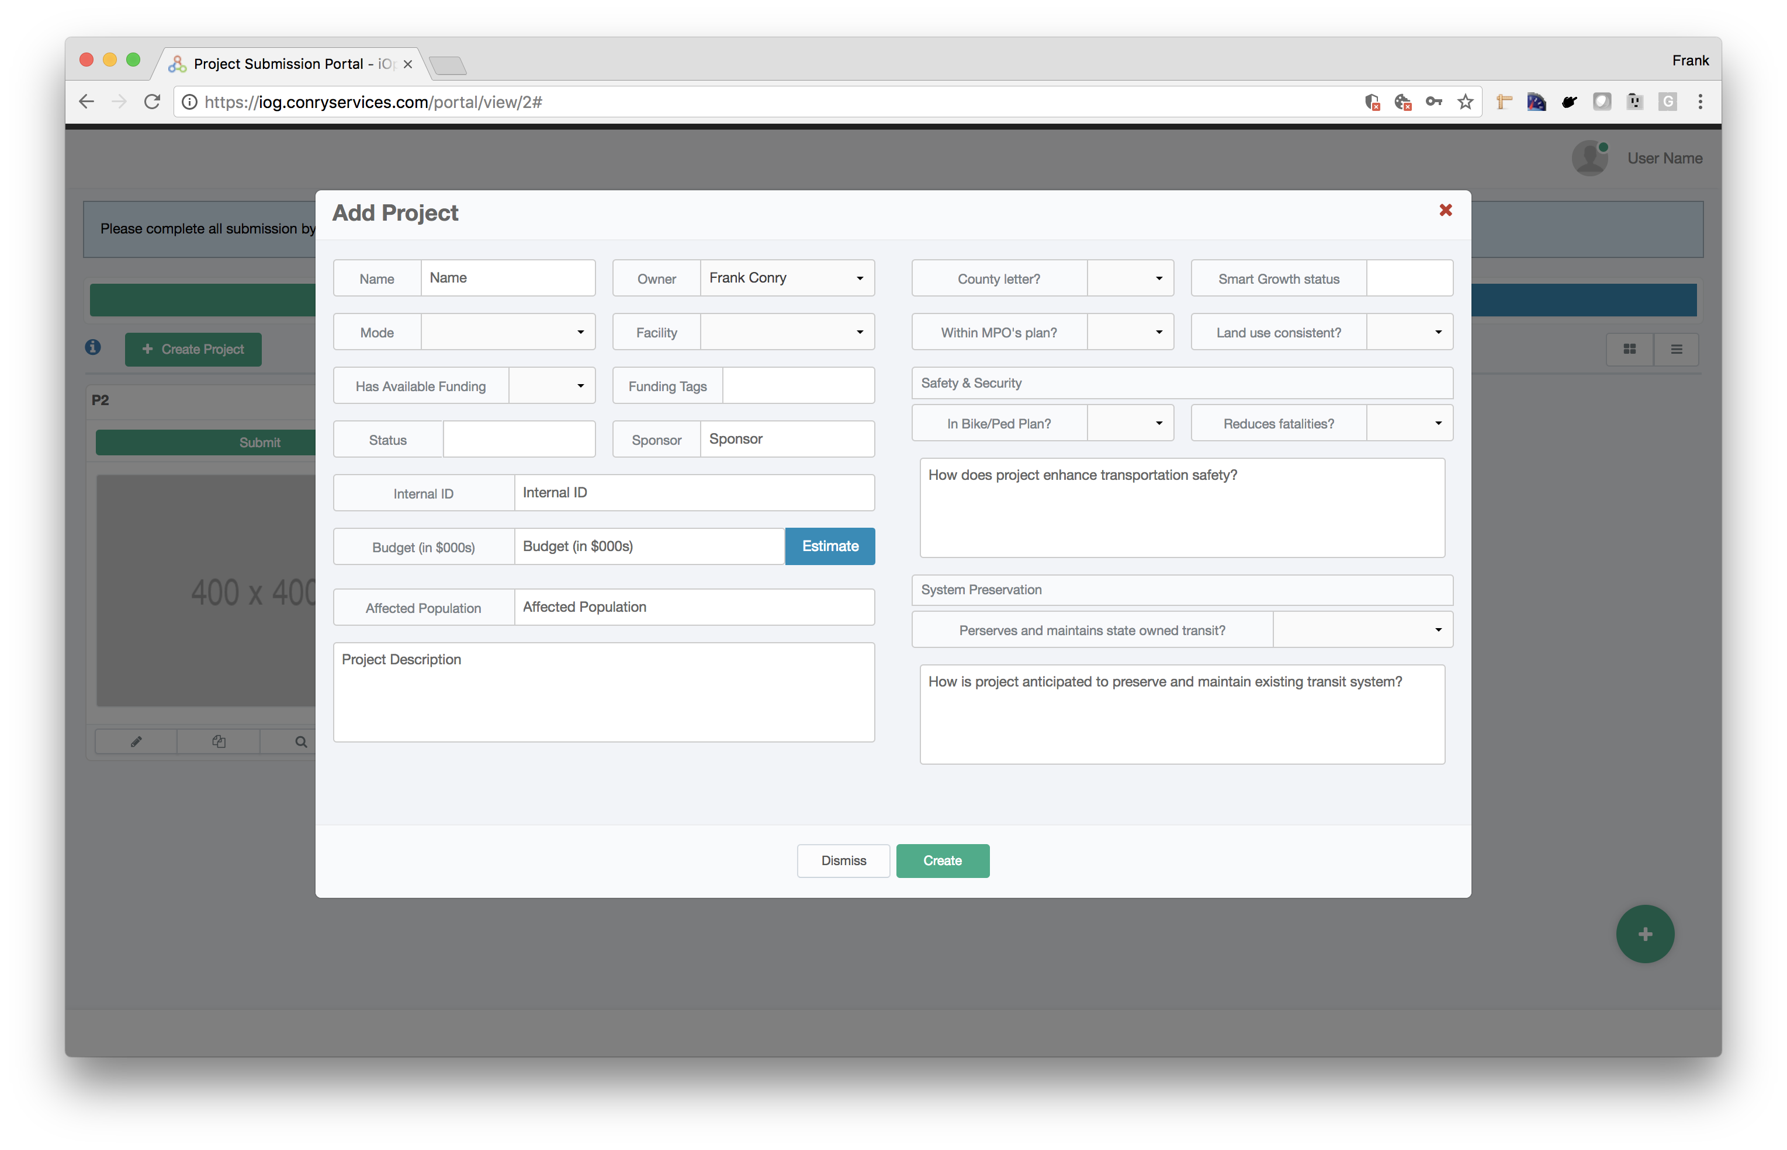
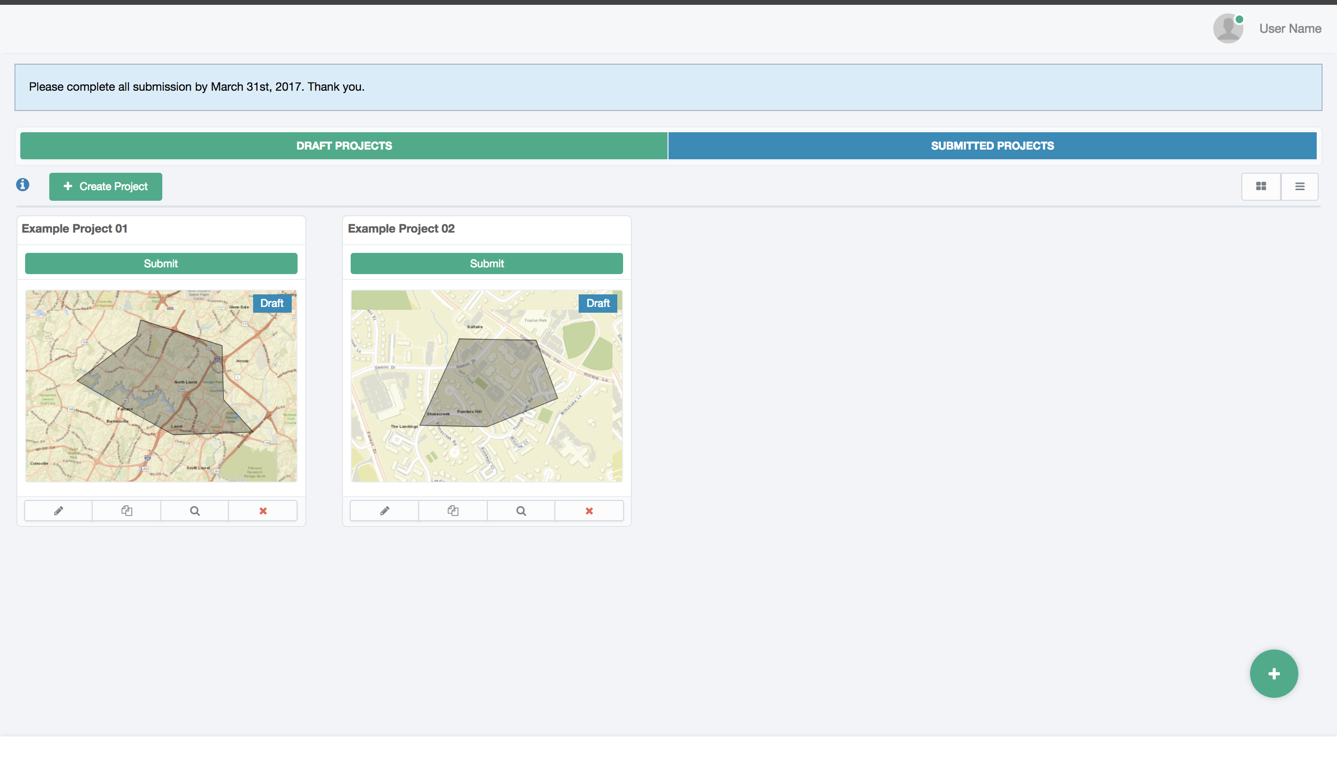
How to Request Major Transportation Projects
    Proposing Entities must submit projects through the Chapter 30 Web Application Portal to ensure the necessary project information and data is provided to conduct the scoring.
    Projects that do not submit applications will not be considered for funding.
    Project Applications request basic project information, evaluation questions and supporting documentation.
    Project Applications are due by March 1st of each year

Slide 18






Project Candidates - What Projects Require Scoring
    Only Major Transportation Projects are required to go through Chapter 30 Scoring Model :
    Highway Capacity Projects Over $5M Transit Capacity Projects Over $5M
            Projects That Do Not Go Through the Chapter 30 Scoring Model are:
            System Preservation Projects Safety Projects
            Non-Highway/Transit Capacity Projects All Capacity Projects Under $5M

Slide 19
Project Candidates – Need Defined Scope & Cost
To conduct a meaningful evaluation projects need to have a clearly defined scope and cost. Requested projects must have the following completed:
Cost Estimate: Projects candidates need to have a reasonable and updated cost estimate.
  Project Scope: Projects candidates need to have a specific project alignment identified as well as defined improvements being proposed.
  Proposing entities can work with MDOT SHA or MDOT MTA to include their project in the Development & Evaluation (D&E) Program of the CTP to complete preliminary planning to establish a clearly defined scope and cost.
  Proposing entities can also fund a Feasibility Study & Cost Estimate themselves in order for a project to be eligible for funding consideration through the Chapter 30 Scoring Model.

Slide 20
Chapter 30 vs Priority Letter Process
    Chapter 30 Scoring
        Only Applies to Major Transportation Projects over $5 Million
        Requires Separate Application Process for Funding Consideration
        Requires Project, Cost & Local Impact Information
        Applications are Due March 1st
    Priority Letter Process
      Utilized by MDOT to consider system preservation, safety and all highway/transit capacity or enhancement projects under $5 million, TOD designations, local transit or aviation projects, etc.
      Priority Letters shall still include Major Transportation project priorities but they will not be evaluated and considered for funding if they do no have a Chapter 30 Application submitted by March 1st.
      Does Not Require an Application or Any Project Data
      Priority Letters are Due April 1st

Slide 21
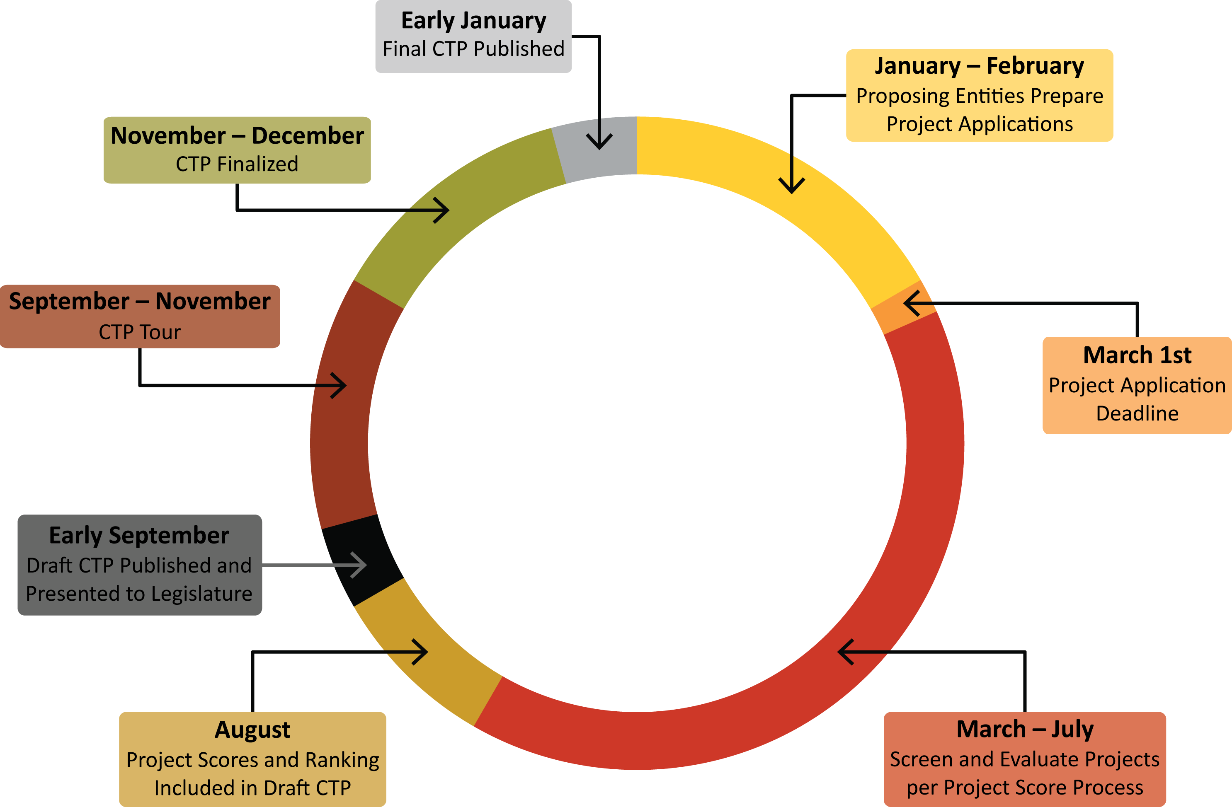
Chapter 30 Scoring - Program Timeline

Slide 22

Additional Information
More detailed information on the proposed Chapter 30 model and process can be found on MDOT’s website at:
http://www.mdot.maryland.gov/newMDOT/Planning/Project_Score/index.html

